Slide 1
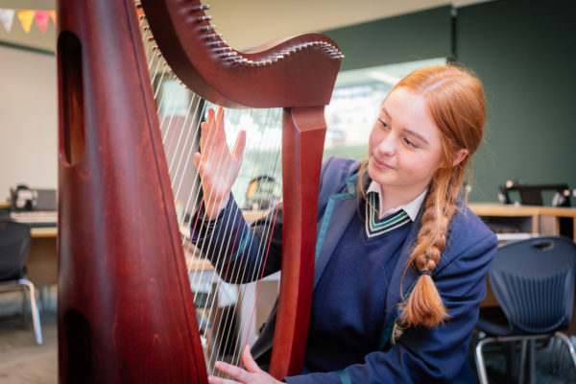
Route two:
Humanities

Slide 2
Options
Route two: Humanities
Core
Block A
History
Geography
English Language & Literature
Mathematics
RE
Science
Core PE
PHSE
Hospitality & Catering Tech Award
Three Dimensional Design
Textile Design
Block B
2nd humanity (History/Geography)
Spanish
French
BTEC Digital Information Technology^(1)
Art & Design – Fine Art
Music^(1)
BTEC Business & Enterprise^(1)
BTEC Sport^(1)
Sociology
Art & Design – Photography
BTEC Performing Arts (Dance)
Block C
A maximum of two class per Block C subject unless indicated as 1 class by ^(1)
& excluding languages and humanities

Slide 3
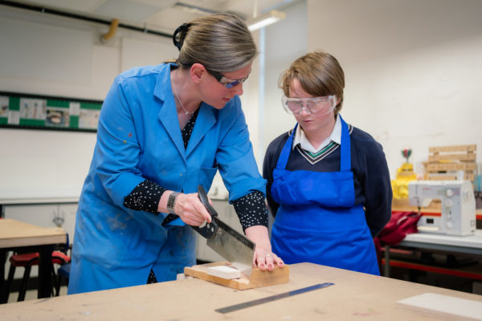
Route Three: Open

Slide 4
Options
Route Three: Open
Core
Block A
Art & Design – Photography
English Language & Literature
Mathematics
RE
Science
Core PE
PHSE
Hospitality & Catering Technical Award
Three Dimensional Design
Textile Design
Block B
French
Spanish
History
Geography
BTEC Digital Information Technology ^(1)
Art & Design – Fine Art
Music^(1)
BTEC Business & Enterprise^(1)
BTEC Sport^(1)
BTEC Performing Arts (Dance)
Block C
A maximum of two class per Block C subject unless indicated as 1 class by ^(1)
& excluding languages and humanities

