Slide 1
Curriculum
Routes
Y9
EBacc
A-Levels
Further Education
Apprenticeships
Employment
Humanities
Open

Slide 2
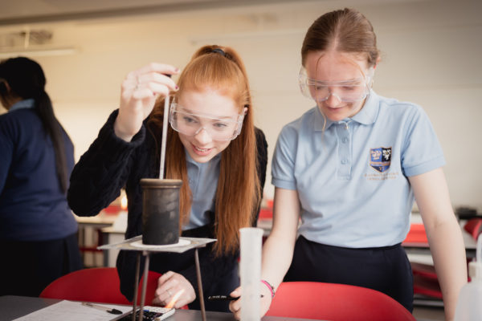
Route one: EBacc

Slide 3
Options
Route one: EBacc
History
Geography
Block A
Core
Spanish
Block B
English Language & Literature
Mathematics
RE
Science
Core PE
PHSE
2nd humanity (History/Geography)
2nd language (French)
BTEC Digital Information Technology ^(1)
Art & Design – Fine Art
Hospitality & Catering Technical Award
Music^(1)
BTEC Business & Enterprise^(1)
BTEC Sport^(1)
Three Dimensional Design
Textile Design
Sociology
*If your child would like to study a different language to the language they have studied in years 7-9 please ask them to see Mrs Cousin (Acting Head of MFL).
A maximum of two class per Block C subject unless indicated as 1 class by ^(1)
& excluding languages and humanities
Block C

Slide 4
Route one: EBacc
Who is this route suitable for?
Based on a range of data and feedback from subject teachers we will identify which students are suitable for the EBacc route
At St Anthony’s all students who have this aptitude will be placed onto this route

