Slide 1
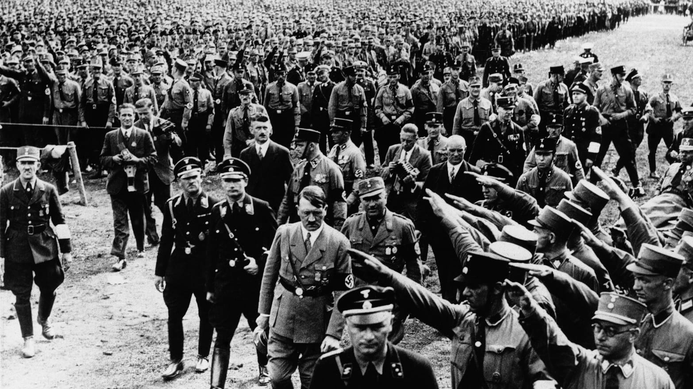
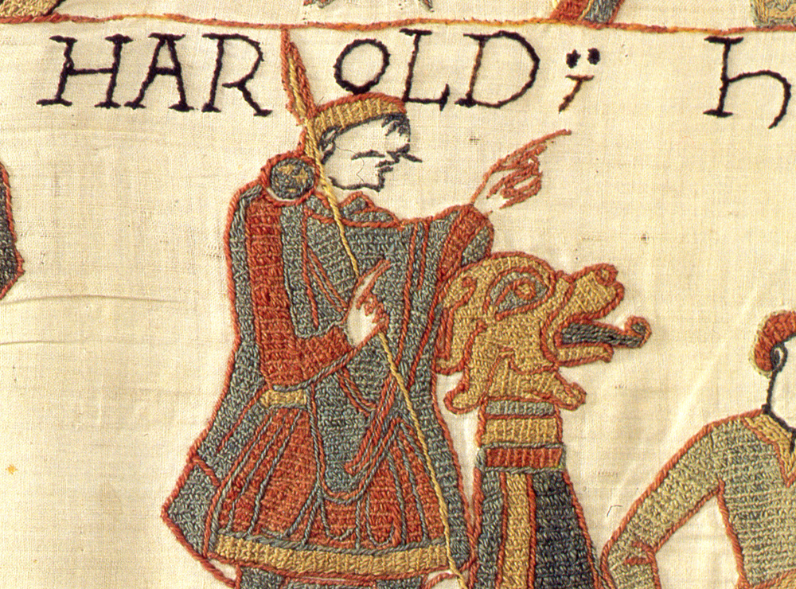
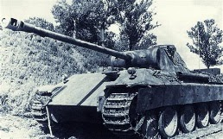
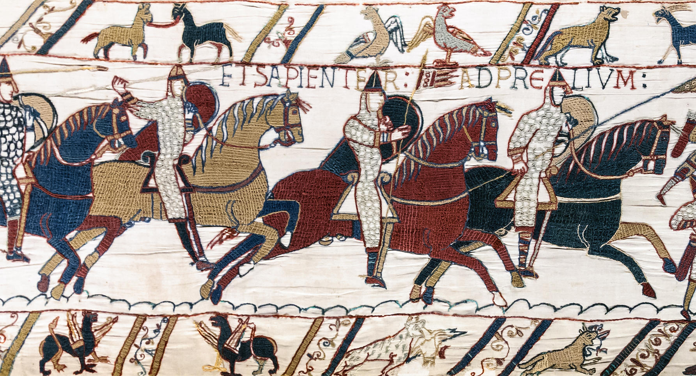
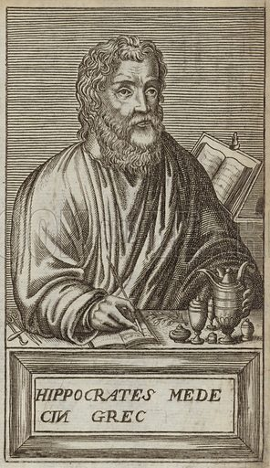
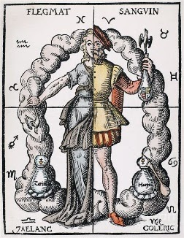
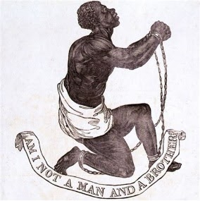
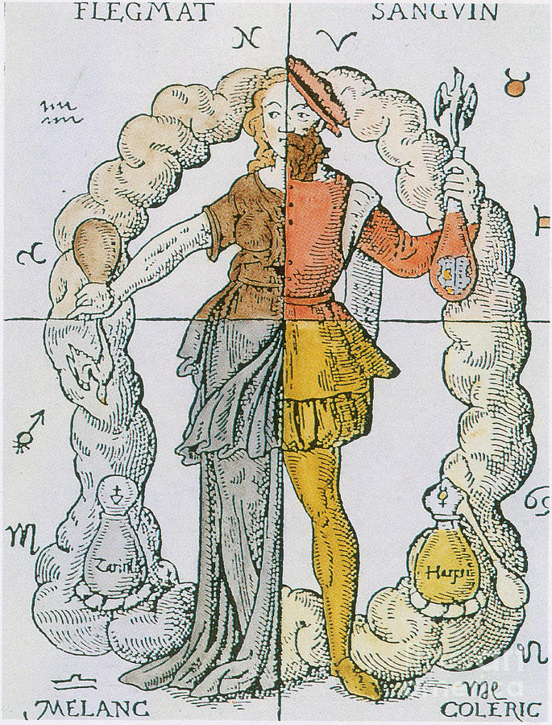
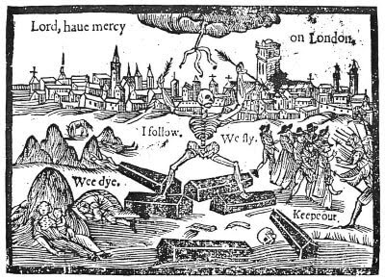
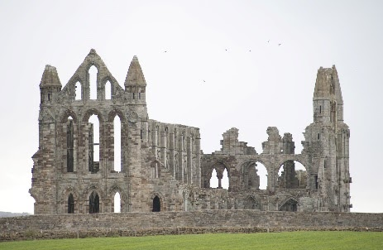
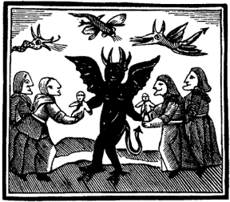
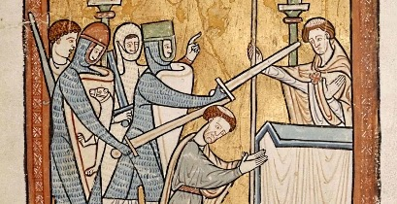
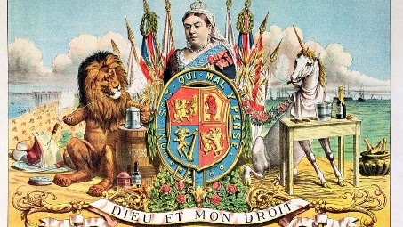
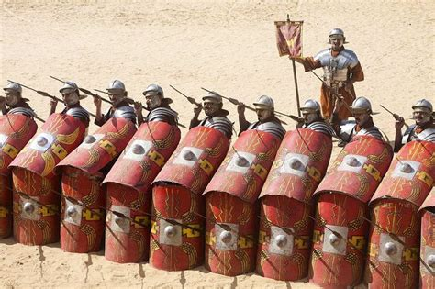
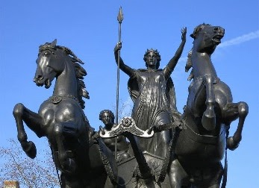
In history we aim to enthuse pupils with an interest in the academic discipline of history. We aim to enable pupils to develop the key skills of the discipline to be able to write like confident historians. Our curriculum allows all pupils to reach their potential both academically and socially. We aim to inspire interest, and encourage pupils to reflect on the lessons the modern world can take from a study of the past. We aim for pupils to develop a sense of context whereby they can make better sense of the conflict and tension in the modern world
History Curriculum Map
Final Exam Preparation
Nazi Germany
Weimar Germany
Pupils in Y11 continue to study Germany with a focus on the rise of the Nazi Party. They focus on how the Nazi state consolidated its power over ordinary Germans. They also study the attempts b the Nazi state to control education and media. An analysis of those who resisted the Nazis is carried out. The final focus is on the treatment of minorities and the Holocaust
Anglo-Norman England
Pupils start Y11 by focusing on politics, culture and society in Weimar Germany. Here they focus on the legacy of the Treaty of Versailles and the economic crises experienced by Germany during the 1920s
Topic 2
Pupils continue to study the threats William faced, even from his own supposedly loyal Normans. They focus on the effects of ‘Normanisation’, the whitewashing of Anglo-Saxon architecture and culture. The final focus is on the death of William and the battle between his sons to assert control over the lands that William once controlled
YEAR
11
Topic 1
Anglo-Norman England
Anglo Saxon England
Medicine in the Trenches of WW1
Pupils move on to study the violent takeover of William the Conqueror. They study the Battle of Hastings, and the reasons for William’s victory. They then study the methods used by William to assert his power over England whilst considering the many threats and rebellions he faced
Pupils begin to study Anglo-Saxon England, specifically focusing on the legacy of the death of Edward the Confessor. They focus on the many rival claimants to the throne and the short reign of Harold Godwinson
Here pupils focus on the many medical issues experienced by solders in the trenches on the Western Front. They will study the many physical and psychological ailments, and the responses to them from medics. Pupils will understand the many breakthroughs made during WW1 and will analyse the impact that warfare had on the development of medicine
YEAR
Topic 2
10
Topic 1
Topic 5
Medieval Medicine
Renaissance and Early Modern Medicine
Modern Medicine
Here pupils in Y9 start to study the power of the medieval church over medical ideas and progress. They study the struggles made by those in the medieval world trying to deal with disease. They will consider the many supernatural and illogical responses to disease and consider why there was a lack of progress
In this topic pupils will start to consider how medicine started to develop. They will focus on a range of individuals and inventions that propelled medicine forward. They will consider the importance of Germ Theory and study how this theory transformed medicine
Pupils continue their study of medical development and focus on the major developments of the 20th century including the discovery of magic bullets and Penicillin, and the birth of the NHS
Ancient world medicine
Topic 2
Topic 3
Topic 4
Here pupils begin to study the ideas of famous physicians of the ancient world: Aristotle, Hippocrates, and Galen. They start to consider how the ideas of these famous physicians affected medicine through time
The Growth of Women's’ Rights
The Growth of Political Rights
The Growth of Civil Rights
Enslaved people
Pupils end Y8 end with a study of Women’s Rights. They study the suffrage movement, the successes and failures of it. They consider this in light of their understanding of women’s lives during the ‘witch craze’
Pupils now study the development of political rights in the UK. Parallels are drawn with topics in Y7 when medieval people protested unsuccessfully. Pupils focus on Chartism and those who gave their lives to be given the right to vote
In this topic pupils continue the story of enslaved people, from abolition to segregation. They study the lives of the descendants of those enslaved and how they fought for greater civil rights in the USA.
In topic 2 pupils move onto study the darker side of the Industrial Revolution and British Empire. They focus on the vast number of enslaved peoples from Africa. They study their enslavement and their lives from the middle passage across the Atlantic to live on plantations. Pupils also focus on the abolition movement
Topic 1
YEAR
9
Topic 5
Topic 3
Topic 4
Topic 2
Everyday lives
Industrial Revolution and Empire
Topic 3 allows pupils to consider the lives of ordinary people in medieval society. They add this to their existing knowledge of medieval monarchs from topic 2. Here Y7 study medieval towns, everyday life, disease epidemics, and the impact of the church on normal lives
Pupils start Y8 with a study of the Industrial Revolution in England. They focus on the reasons for it, the inventions created, and the enormous impact on society. Pupils connect this to a study of a growth of the British Empire.
YEAR
Topic 4
Topic 5
8
Topic 1
Medieval Monarchs
Topic 3
In their second topic Y7 pupils begin to study medieval monarchs; their power struggles, and relationships with their ordinary subjects
Medieval Monarchs
The Lives of Women
Topic 2
In topic 4 Y7 pupils continue to study more medieval monarchs whilst developing their chronological understanding. In this topic pupils study conflict, and the impact of it on English society. They study the political conflict of the Wars of the Roses and the religious conflict of the Tudor and Stuart reigns
In topic 5 pupils refocus on the lives of ordinary people. This time with a specific focus on the lives of women in England in the sixteenth and seventeenth centuries. Pupils consider the reasons for the ‘witch craze’ and study the lives of women affected by it. This study of women, and their lack of rights, feeds into their examination of female suffrage groups in Y8
YEAR
Topic 1
7
Key skills and Roman Britain
Pupils begin their journey by developing their knowledge of skills vital to the historian. This allows pupils to start to think and write like historians straight away. Pupils move on from this to study the Roman invasion of Britain and resistance to this invasion
“That men do not learn very much from the lessons of history is the most important of all the lessons that history has to teach" Aldous Huxley
Topic 4

